Slide 1

Super Forecasters
Project Proposal Pitch
Andrew Mao, Faraz Ahmed, Pedro Armengol

Slide 2
Agenda
Problem/Goal
Data Collection/Manipulation
Analysis/Forecasting/Visualization
Timeline

Slide 3

The Problem/The Goal
Crime rates: heterogeneous
Which are the factors that are correlated to crime?
With those factors, can we predict crime?
Goal: Find out the set of variables most closely correlated with crime,
and predict with a certain level of accuracy where and when
next crime will take place.

Slide 4
Data Collection
Sample data collection sources:
1)Crime data: monthly/municipality level:
National System of Crime Data
2)Demographic information: yearly/municipality level: National Statistics Bureau (NSB)
3) Employment rates: yearly/municipality level: National Insurance Institute
4) Geo. Attributes: municipality: NSB
5) Economic activity/Cost of living: quarterly municipality: Economic Ministry
Data cleaning Procedure:
Scrapping data
Standardize data to same units
Design the database/tables (SQL)
Sort/merge/link (relational database)
Predicted
variables
Predicting
variables
Sample Independent Variables
-Economic activity
-Cost of living
-Population
-Education rates
-Employment rate
-Geo. Attributes
-Time trends
Crime rates

Slide 5
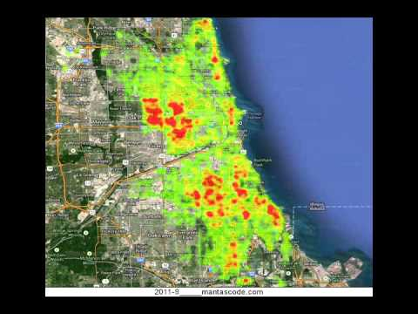
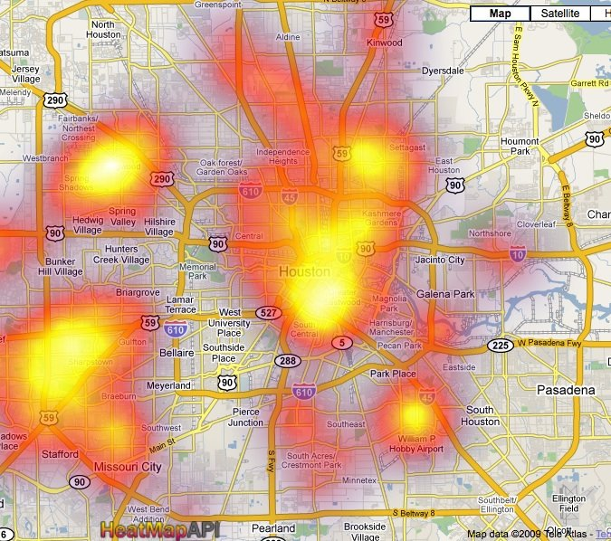
Analysis
Covariate Analysis
LASSO (Least absolute shrinkage and selection operator)
Heat Map Visualization/Dashboard
Prediction & Forecasting

Slide 6
Timeline
Gather data
Clean collected data
Standardize and merge data
Examine patterns, perform analysis and apply forecasting techniques
Develop the dashboard (with heat maps)
4th – 6th Week
6th – 8th Week
8th – 10th Week

Slide 7
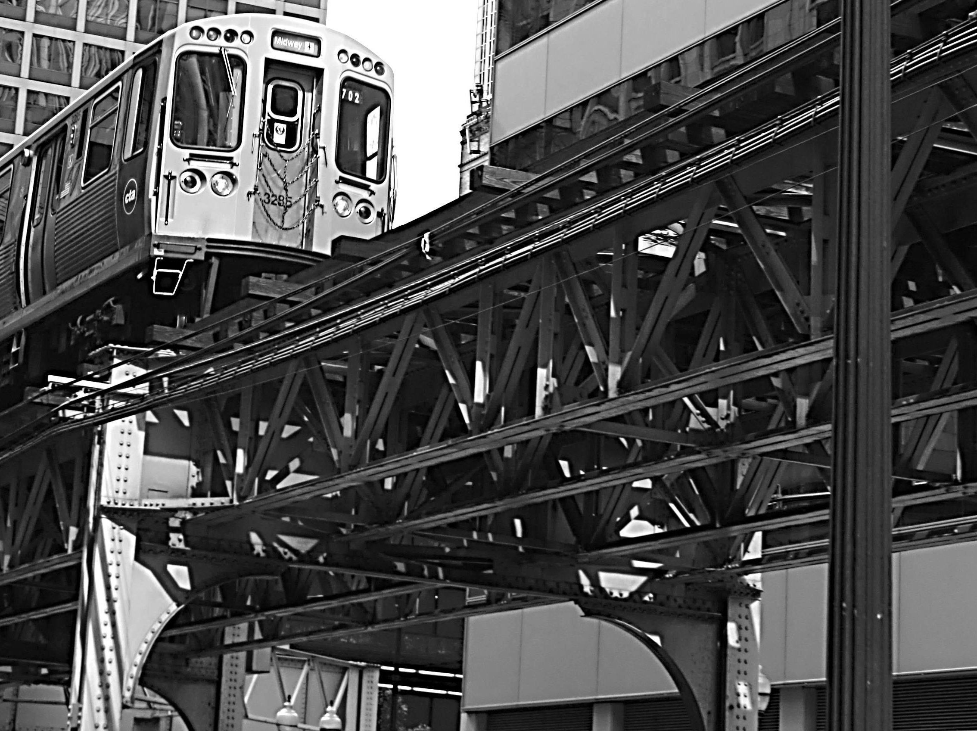
Thank you for listening!
Questions are welcome

